Slide 1

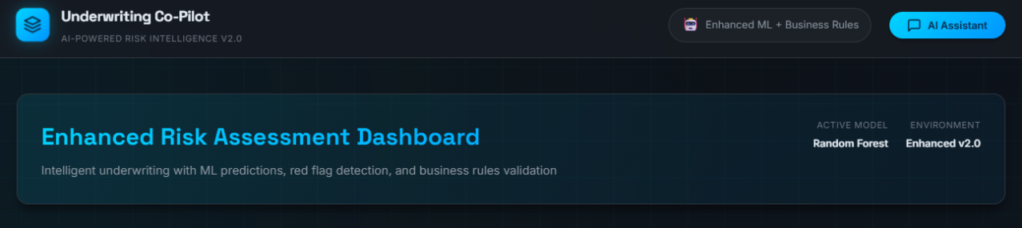
AI-Driven Insurance Underwriting Co-Pilot
Using GenAI, Agentic AI, ML, Flask & Full-Stack Web App
Leveraging artificial intelligence to enhance insurance underwriting efficiency, accuracy, and decision-making capabilities in the digital age.
Presented By: ARUSHI SHIVHARE, PRN: 22070521062
ANMOL CHOURASIA, PRN: 22070521091
Symbiosis Institute of Technology Nagpur

Slide 2
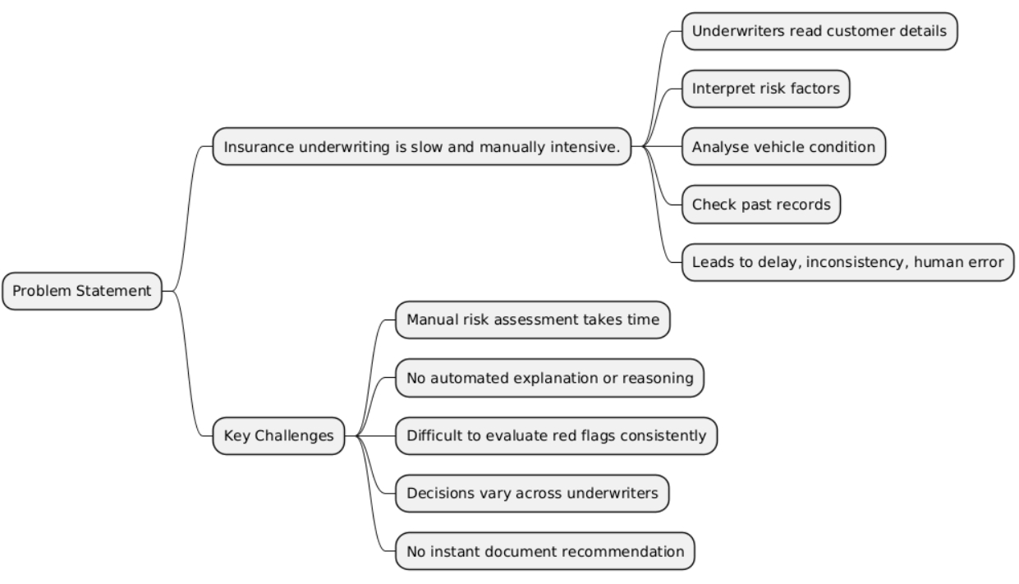
Problem Statement
Insurance underwriting is traditionally slow and manually intensive. Underwriters must read customer details, interpret risk factors, analyse vehicle condition, check past insurance records, and make decisions. This leads to delays, inconsistency, and human error.
Key Challenges:
Manual risk assessment takes time
No automated explanation or reasoning Difficult to evaluate red flags consistently Decisions vary across underwriters
No instant document recommendation

Slide 3
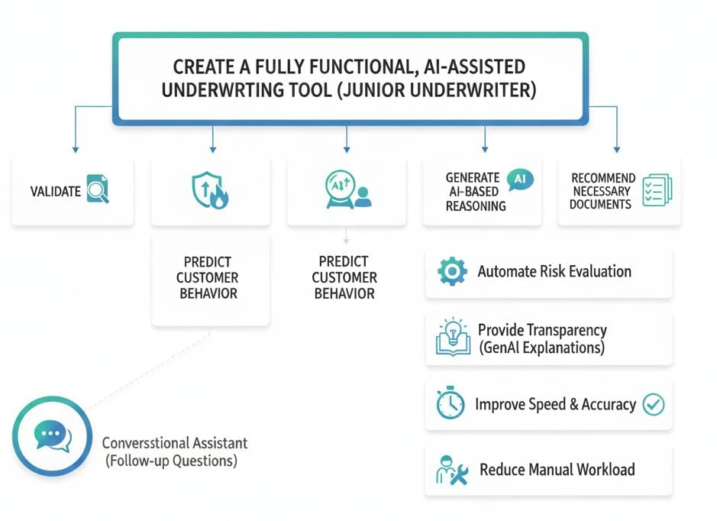



Project Objective
The goal was to build a fully functional, AI-assisted underwriting tool that acts like a junior underwriter. The system should validate data, evaluate risk, predict customer behaviour, generate AI-based reasoning, and recommend required documents4all in one interface.
The system aims to:
Automate underwriting risk evaluation
Provide transparency through GenAI explanations
Improve decision speed and accuracy
Reduce manual workload
Offer a conversational assistant for follow-up questions

Slide 4
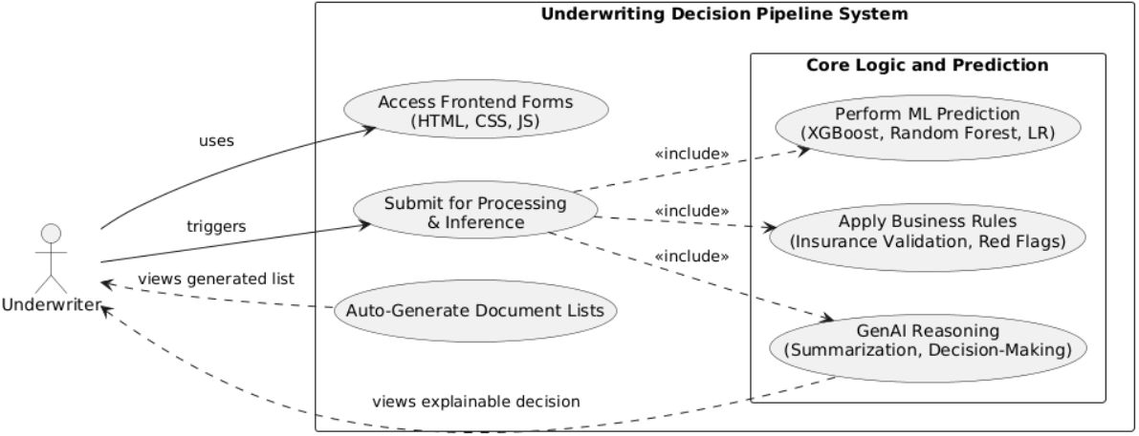
Architecture Overview
The application integrates frontend forms, backend processing, ML prediction, business rules, and a GenAI reasoning chain. Every layer supports the underwriter with a clear, explainable decision pipeline.
Main Components:
Frontend: HTML, CSS, JavaScript Backend (Dashboard UI) : Flask API for processing and inference
Machine Learning: XGBoost, Random Forest, Logistic Regression Business Rules Engine: Insurance validation + red flags
GenAI Agent: Multi-stage summarization, reasoning, Decision-making Document Engine: Auto-generated document lists

Slide 5
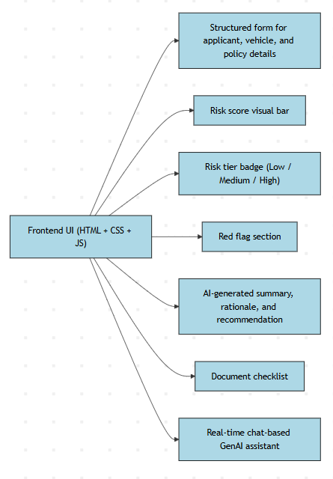
Frontend UI (HTML + CSS + JS)
The dashboard collects customer data and displays the results in a clean and interactive layout. JavaScript handles form submission, dynamic visual updates, and chat interactions.
Key Features:
Structured form for applicant, vehicle, and policy details Risk score visual bar
Risk tier badge (Low/Medium/High) Red flag section
AI-generated summary, rationale, and recommendation
Document checklist
Real-time chat-based GenAI assistant

Slide 6
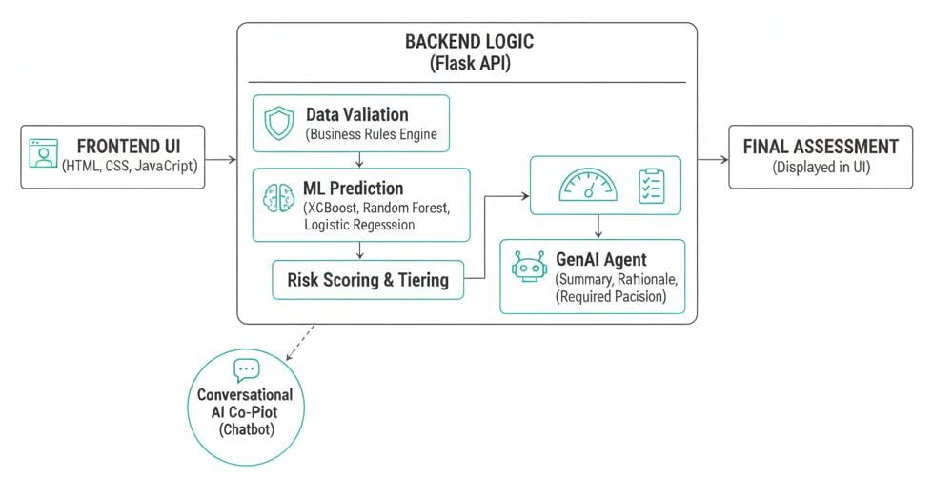
Backend Logic (Flask Application Flow)
The backend acts as the central processor. When the user submits the form, Flask handles validation, ML inference, risk scoring, and AI generation through a clear pipeline.
Steps Performed:
Receive form data
Validate using insurance business rules Generate warnings & red flags
Engineer features for ML model
Run risk prediction
Compute composite risk score Call GenAI chain for explanations
Generate recommended documents
Return complete JSON response to UI

Slide 7
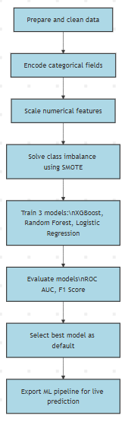
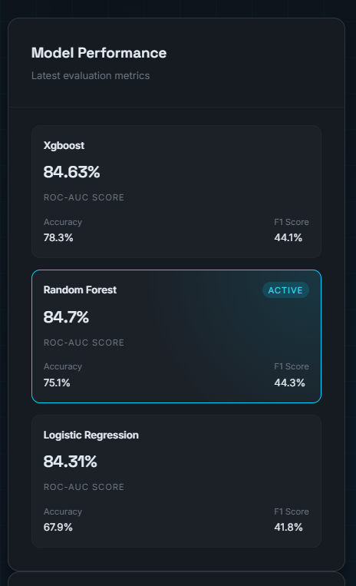
ML Pipeline (Training Prediction)
Machine Learning models help predict how likely a customer is
to purchase insurance. This gives the underwriter insight into customer behaviour, which is combined with risk factors to calculate the final risk tier.
Pipeline Steps:
Prepare and clean data Encode categorical fields Scale numerical features
Solve class imbalance using SMOTE
Train 3 models: XGBoost, Random Forest, Logistic Regression Evaluate using ROC AUC, F1 Score
Select the best model as the default
Export the ML pipeline for live prediction

Slide 8
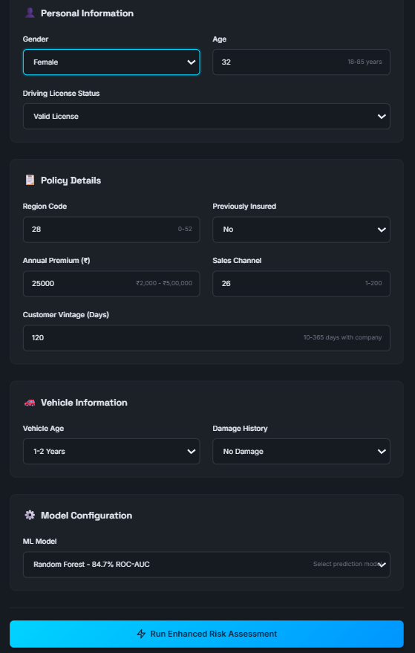
Underwriting Insurance Terms Used
The application uses real underwriting concepts to ensure decisions resemble actual industry practice.
Important Terms:
Red Flags: High-risk indicators (No license, damage history, no insurance) Risk Tier: Overall classification (Low/Medium/High)
Business Attractiveness: Probability that customer will buy insurance Underwriting Risk: Riskiness of issuing the policy
Composite Risk Score: ML prediction + red flag weighting
Document Requirements: Papers needed for underwriting approval

Slide 9
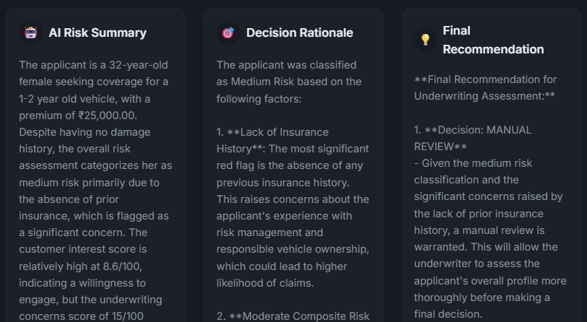
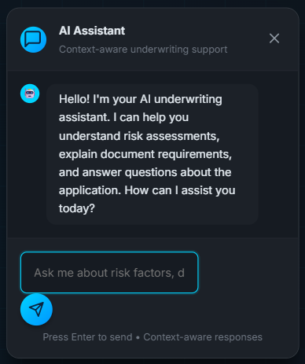
Agentic GenAI Reasoning
The centerpiece of the system is the GenAI agent.
It does not just answer queries for it reasons like an underwriter.
Stage 1: Summary
Provides a short insurance-style summary of the applicant.
Stage 2: Rationale
Explains why the risk is Low/Medium/High, based on input factors.
Stage 3: Recommendation
Gives the final underwriting decision + conditions.
This makes the system transparent and explainable.
Stage 4: Chat Co-Pilot
Answers follow-up questions using full case context.

Slide 10
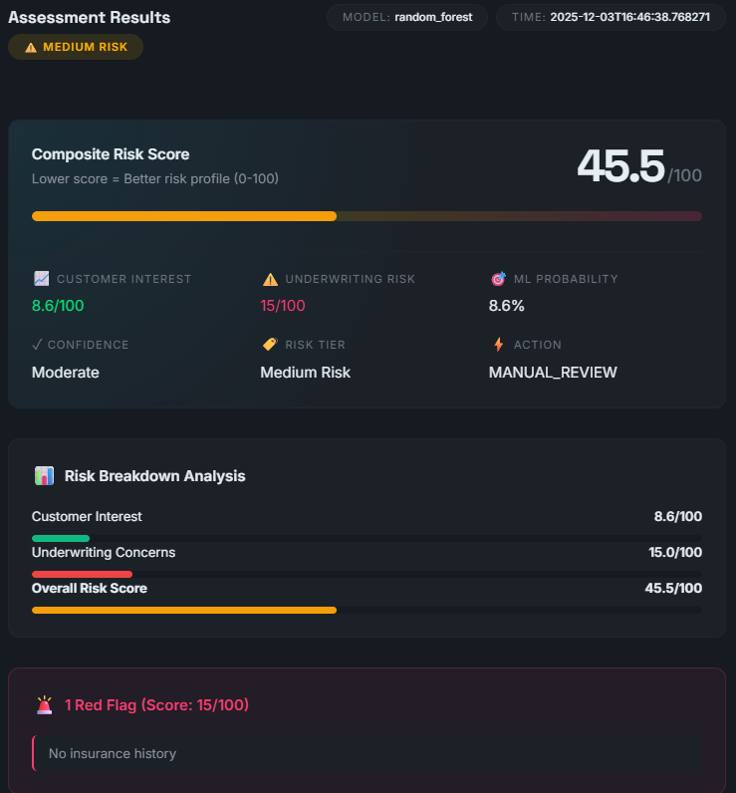
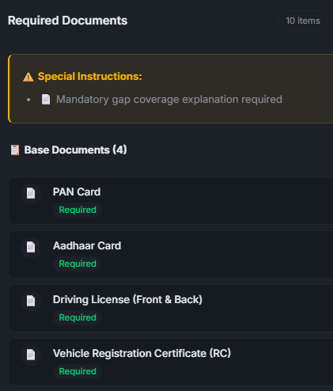
Document Recommendation Engine
The document engine automatically determines which documents the customer must submit.
This helps underwriters ensure completeness and reduces back-and-forth communication.
Document Logic Uses:
Risk tier (Low/Medium/High)
Red flags (damage, no previous insurance, low premium) Age group
Vehicle condition
Documents Generated:
Basic KYC
Previous insurance papers Vehicle inspection reports Income proof / bank statements Damage photos / repair invoices
Special instructions for high-risk cases

Slide 11
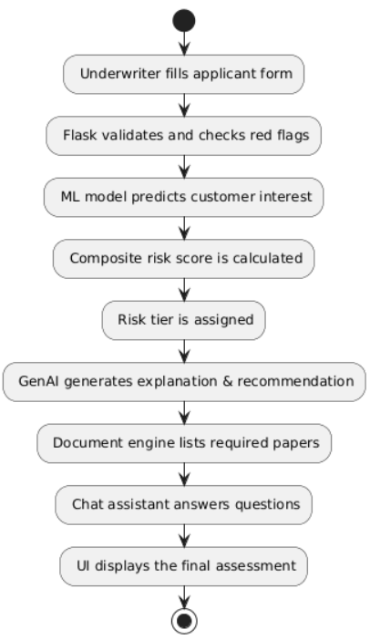
End-to-End Workflow
1. Underwriter fills applicant form
2. Flask validates and checks red
flags
3. ML model predicts customer
interest
4. Composite risk score is
calculated
5. Risk tier is assigned
6. GenAI generates explanationre
commendation
7. Document engine lists required
papers
8. Chat assistant answers questions
9.UI displays the entire final
assessment

Slide 12
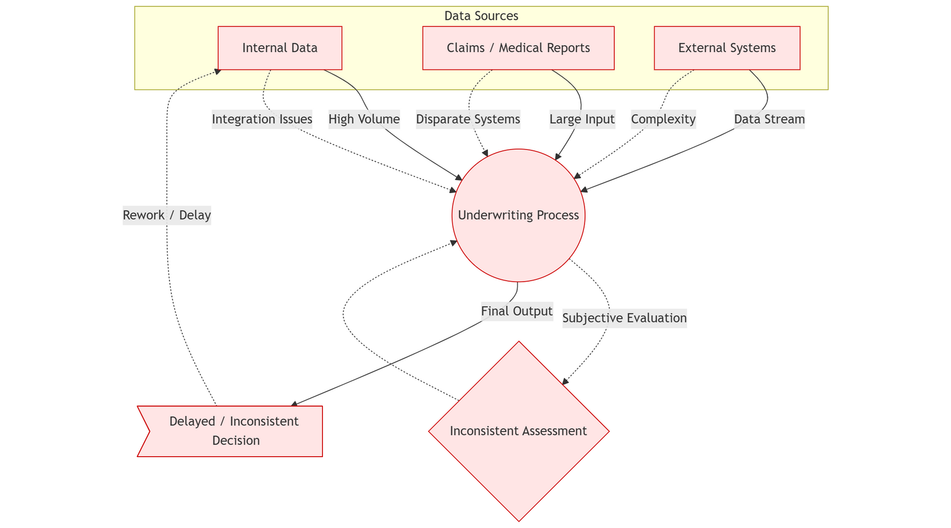
Conclusion
This project demonstrates how combining GenAI, ML, business rules, and modern web technologies can transform complex insurance processes into simple, automated, and intelligent workflows.

Slide 13





Results Impact
Outcome
The system offers a fast, intelligent, and explainable underwriting solution. It significantly reduces underwriting time and improves the decision-making experience.
Impact:
Faster underwriting decisions
Better risk understanding through explainable AI
Reduced manual work for underwriters
Accurate and consistent results
Smart document guidance
A real conversational AI co-pilot
Complete full-stack implementation

Slide 14

Thank You!
We appreciate your time and attention today.

